Slide 1

Crafting ColdFusion Applications Like An Architect
Adobe ColdFusion Summit 2016

Slide 2

Who am I
Shirak Avakian
Enterprise Solution Architect
QBI LLC
shirakavakian@gmail.com
@shirakavakian
No Facebook

Slide 3
Subjects to cover
Questions to answer
Software architect vs building architect
Software architect vs code

Slide 4
Questions to Answer
How do I start a project?
How do I find resources?
How do I collect business requirements?
How to design my business entities?
Do I need services/API?
Do I need framework?
How to make my code cleaner?
Is ColdFusion got me covered?
How to prepare my demo for upper management.?
Any thing else?

Slide 5
Questions to Answer
Read Initial specification
Visualize
Know your environment
How do I start a project? How do I find resources? How do I collect business requirements? How to prepare my demo for upper management.
Meet with users ( not managers )
Write down any manual process
Draft your solutions
Timeline/budget
Define/Find resources
Craft your first demo

Slide 6
Questions to Answer
How to design my business entities?
Normalize Backend (database) SQL/No SQL
Do not overwhelm your OOP
Do I need services/API?
Yes if you want to serve somewhere else
No for else
Do I need framework?
Yes (period)
No if you want to embarrass yourself
How to make my code cleaner
Follow one coding standers and be consistence
Generate Table Objects / DAO
Yes if you want to make your application loosely coupled
Write comments
Clean up your code
No if you want to demo proof of concepts

Slide 7
Understanding Software Architect

Slide 8
Software Architect
Software architecture refers to the high level structures of a software system, the discipline
of creating such structures, and the documentation of these structures.
Facts
Software architecture is about making fundamental structural choices which are costly to change once implemented.
Software architecture is all about structures not technology
Software architecture must have long term vision
Business requirement is a key factor to start software architect
Communication in software architect play big role on final outcome
Software architect should represent your system without compromises.

Slide 9
Software architecture start point

Slide 10
Software architecture start point
1- Step 1
Get the business requirements
Meet with Network administrator
Meet with dba
Sit down with actual employee (not a manager) and try write down all manual processes
2- Step 2
Putting things together
Choosing database
Choosing Technology
Cloud vs in-house

Slide 11
Software architect vs building architect
Best way to explain the digital world is by
Comparing with physical world

Slide 12
Software architect vs building architect
Building Architecture: Is both the process and the product of planning, designing, and constructing buildings and other physical structures.
Software Architecture: Is both the process and the product of planning, designing, and coding softwares and other physical/digital requirements.

Slide 13
Let us compare side by side

Slide 14
Software architect vs building architect
Steps | Building | Software
1 | Meet the owner go over his/her vision | Meet with the department to go over their business requirements
2 | Lot size, city code, structure, square footage | Domain, application type, load, budget
3 | Provide blue print | High level diagram of application process

Slide 15
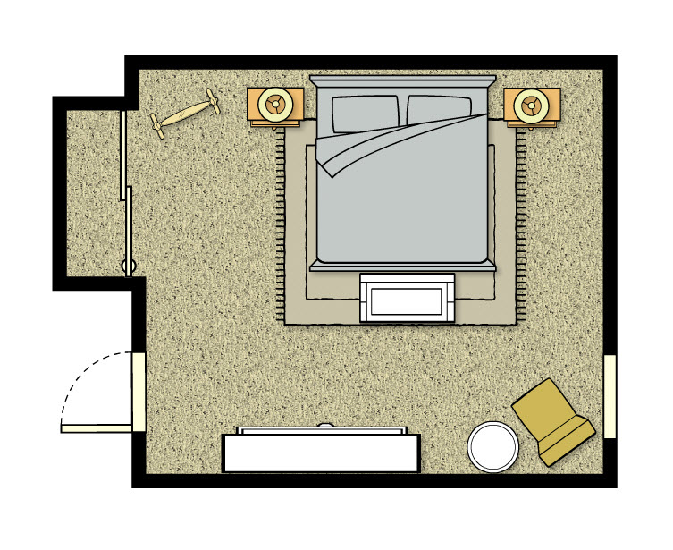
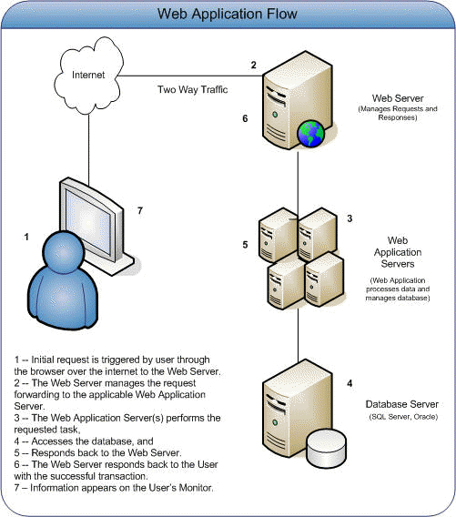
Software architect vs building architect
Building room floor plan
Application servers diagram

Slide 16
Let us Convert the room
to ColdFusion Code

Slide 17
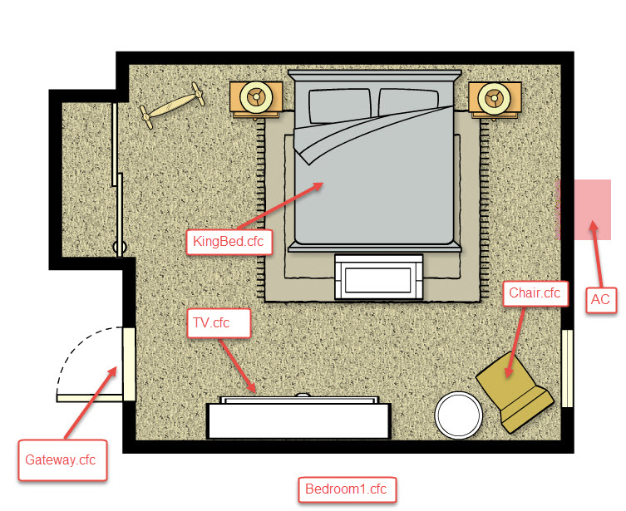
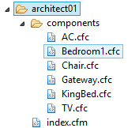
Software architect vs building architect
See Architect 01 source code

Slide 18
Software architect vs building architect
How do I know which method belong to which component?
Ask the component! If it make sense then it belongs to it
Example: HasChair() method makes total sense when you ask the Bedroom1.cfc
Can you ask Bedroom1 HasCar()? NO
See Architect 01 source code

Slide 19
Software architect vs building architect
Structure
Bedrom1
AC
Furniture
KingBed
Operations
getACType
TV
getChairColor()
Chair
hasChair()
hasTV()
hasBed()
hasFurniture()
Service Factory
Building
Packages
Business functions/objects
Services
See Architect 02 source code

Slide 20
Software architect vs code

Slide 21
Software architect vs code
1- Database
Normalize/schema/user defined types
Store procedures / views
2- OOP (Object Oriented Programing)
It is all about objects
Business Entities vs Table Objects/Beans vs View Model
Inheritance
2- SOA ( Service Oriented Architect )
CSOA ( Classic Services Oriented Architect )
SFOA ( Service Factory Oriented Architect )
POA (Package Oriented Architect )
3- MVC Frameworks
The Model
The Controller
The View
Repository
AutoGen/ORM
DAL
Services
UI

Slide 22
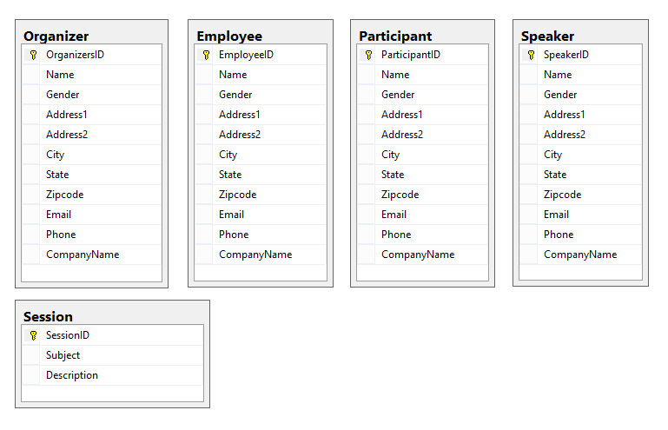
Software architect vs code
Database normalization,
or simply normalization, is the
process of organizing the columns
(attributes) and tables (relations) of
a relational database to minimize
data redundancy.(Wikipedia)
Repository - Database

Slide 23
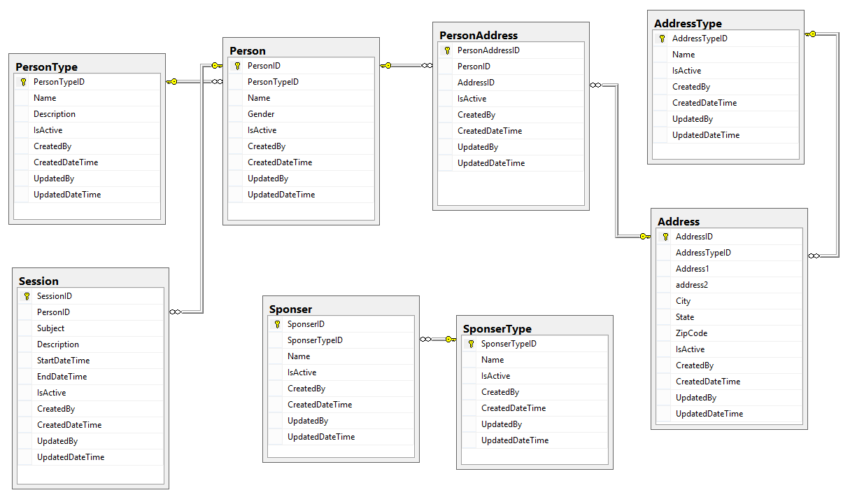
Software architect vs code
Best Practices
1- Normalize your database
2- Create separate SQL authentication
3- Create schemas
4-Create user defined type
4- Use Store procedures & views
5- Prefix store procedures with usp
6- Don’t use plural form for tables names
7- Always create diagrams
8- Use constrains & foreign key’s
9- Use SQL Identity Increment
10- Define your primary keys
11- Always have common fields (columns)
Repository - Database

Slide 24
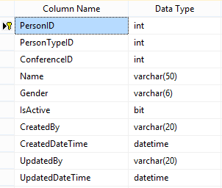
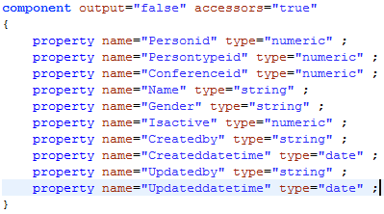
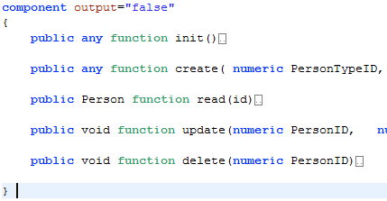
Software architect vs code
Person Table
Person.cfc (Table Object)
Repository – OOP- AutoGenerated/Table objects/ DAO
PersonDAO.cfc (Data Access Object)

Slide 25
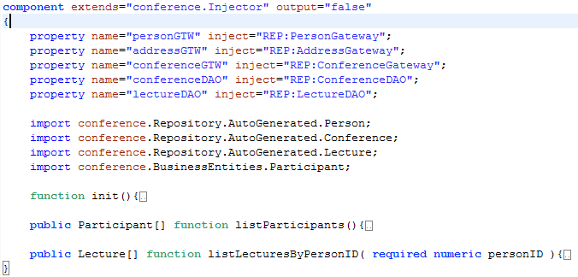
Software architect vs code
DAO (Data Access Object) vs DAL (Data Access Layer)
PersonDAO.cfc (Data Access Object)
PersonDAL.cfc (Data Access Layer)
Repository – OOP- DAL-Business Entities
1- No Inheritance
2- Represent single table
3- No Injectors
4-Output array of table object or query
1- Inheritance
2- Represent multiple table
3- Injectors
4-Output array of Business entities or Procedure struct or query

Slide 26
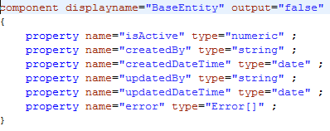
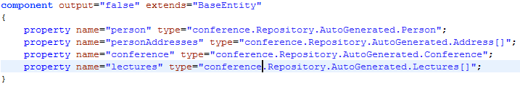
Software architect vs code
BusinessEntites is predefined objects represent services return type.
Repository – OOP- Business Entities

Slide 27
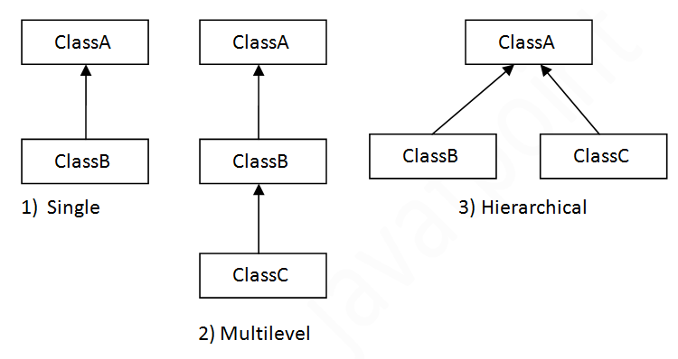
Software architect vs code
Inheritance is a mechanism in which one object acquires all the properties and behaviors of parent object. The idea behind inheritance is that you can create new classes that are built upon existing classes. (www.javatpoint.com/inheritance-in-java)
Repository – OOP- Inheritance

Slide 28
Software architect vs code
A service-oriented architecture (SOA) is an architectural pattern in computer software design in which application components provide services to other components via a communications protocol, typically over a network. The principles of service-orientation are independent of any vendor, product or technology. (https://en.wikipedia.org/wiki/Service-oriented_architecture)
 | Advantages | Disadvantages
1 | Service Reusability | Increased Overhead
2 | Maintainability | Complex Service Management
3 | Reliability | High Investment Cost
4 | Location Independence
5 | Improved Software Quality
6 | Improved Software Quality
7 | Platform Independence
8 | Increased Productivity
Services-COA ( Classic Oriented Architect )

Slide 29
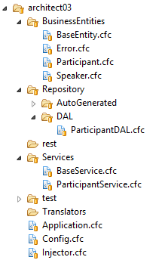
Software architect vs code
Classic Service Oriented Architect
UI-Model
ParticipantService
ParticipantService
ParticipantDAL
ParticipantDAL
Database
listParticipant()
listParticipants()
Services-COA ( Classic Service Oriented Architect )
See Architect 03 source code

Slide 30
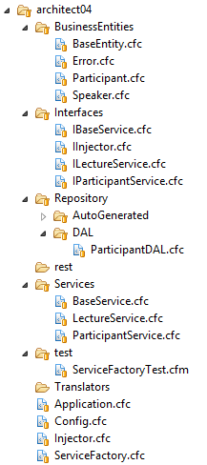
Software architect vs code
Service Factory Oriented Architect
Service Factory
UI-Model
ParticipantService
LectureService
LectureDAL
ParticipantDAL
Validation
OtherDAL
Services-SFOA (Service Factory Oriented Architect )
See Architect 04 source code

Slide 31
Software architect vs code
Package Oriented Architect
UI/Model
Contact Service Package (Contact Gateway)
Address Service
Person Service
Auth Service Package (Auth Gateway)
Login Service
Contact DAL
Auth DAL
Services-SFOA (Service Factory Oriented Architect )
See Architect 05 source code

Slide 32
Software architect vs code
View
Controller
Model
+ Services (API)
See Architect 02 source code

Slide 33
Software architect vs code
1- Normalize database
2- Create your repository components (Data access, ORM)
3- Test Case
4- Define your business entities
5- Create translator
6- Create Services
7- Test Case
8- Define your packages
9- Define your Gateways
10- Test Case
11- Create API, REST
12- Test Case
13- Create your MVC Model
14- Translator for View Model
15- Test Case
16- Controller
17- View
See Architect 02 source code

Slide 34
Software architect vs code
Multi tier application
Database
Repository Component OR Data Access layer
Services
Translator
Model
Translator
Controller
View

Slide 35
Resources
http://www.buzzle.com/articles/advantages-and-disadvantages-of-service-oriented-architecture-soa.html

